Slide 1
Rideshare App
Rahul, Rishi, Seo, Anmol

Slide 2
Project Idea
A carpooling service, where people can share rides with other people travelling on the same route. Thus maximizing the profit of driver and customer and reducing the traffic on road.
Our aim is to create a web app using AWS cloud services stack that allows users to securely coordinate small transfers in the city. The app should be able to accommodate requests from users travelling on the same route and should be able to make small deviations according to users’ comfort.
We will need to implement measures to improve trust and privacy between users sharing rides.
Some ideas possible to implement: Driver’s license and vehicle registration verification, Driver and Customer feedback

Slide 3
Data Sources and API
Additional API Used:
Google Geocoding API: Used to map physical address to latitude and longitude on the map
Google Maps Distance Matrix API: Provides travel distance and time for a matrix of origins and destinations, based on the recommended route between start and end points
Google Maps Driving Direction API: Calculates directions between locations

Slide 4
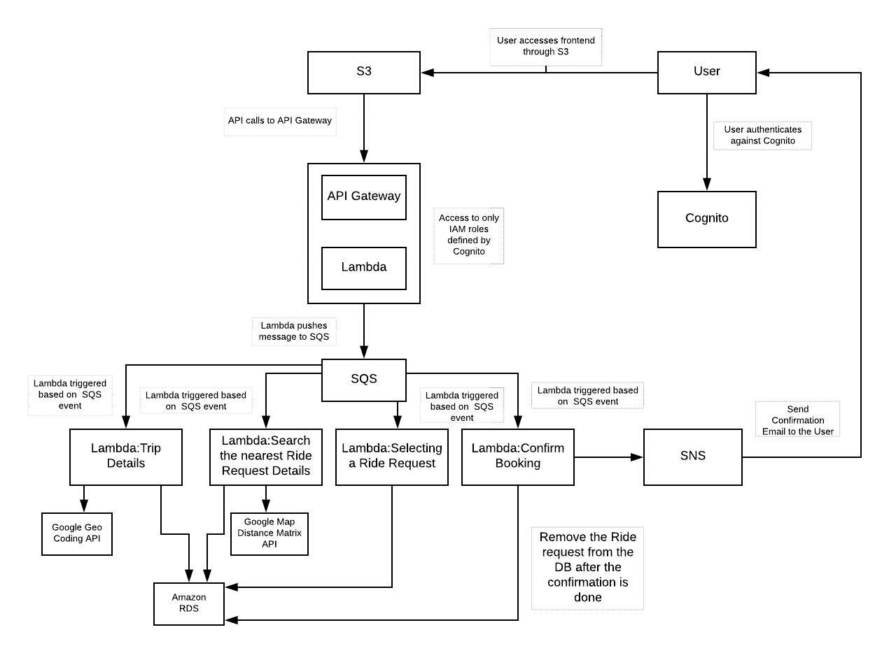
Architecture Diagram

Slide 5
Deliverables (Project result)
A sign-up and log-in function, with email or mobile number verification
Profile page for each user (Customer and Driver)
Drivers can set up their route or trip and expected fare
Customers can set up their route or trip
Customers can search for Driver on their route and vice versa
Booking service with email confirmation
Managing the number of seats left in driver’s ride
Driver and Customer feedback
Optional:
Payment option using third party payment system
Customer feedback based ranking system for the Driver

